Slide 2
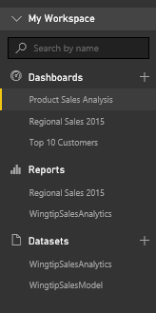
Central Power BI Concepts
Workspace
Provides user context and asset container
Every user has personal workspace
Team development requires group workspaces
Dashboard
Consolidated view into reports and datasets
Custom solution entry point for mobile users
Report
Collection of pages with tables & visualizations
Provides interactive control of filtering
Dataset
Data model containing one or more tables
Can be very simple or very complex
Notes:
You can think of a workspace as a container that holds three different kinds of assets; dashboards, reports and datasets. Every dashboard, report and dataset created in Power BI must be created within the scope of a specific workspace. A workspace also provides a user context because the current workspace always determines which set of dashboards, reports and datasets are visible to the user.
Every Power BI subscriber has a personal workspace which is named My Workspace. An organization can also create app workspaces which make it possible to achieve team-based authoring and staged deployment of custom solutions. The course will go into greater detail on working with app workspaces later in module 7 when discussing how to deploy reports and dashboards.
A dashboard typically serves as the top-level entry point into a custom data analytics solution. In Power BI, a dashboard is created as a consolidated view on top of reports and datasets. Dashboard are also important to Power BI mobile users because there display is often optimized for mobiles devices such as iPhones, Android phones and Windows 10 phone.
A report is a collection of pages that is associated with exactly one underlying dataset. Each page in a report serves as a canvas on which you can add tables, matrices and other types of visualizations. While dashboards are designed to provide a high-level overview, reports are the opposite because they are used to drill down into the lower-level details. Reports also provide much more interactive filtering control for custom solutions in which the user must be given the ability to drill down into further levels of detail.
A dataset is a collection of one of more tables that defines a data model. A simple dataset can contain a single table with three columns and ten rows. However, a dataset often contains multiple tables which has relationships between them. In the upcoming lab exercises in this course, you will design a dataset using all the different query and data modeling features of Power BI Desktop.

Slide 3
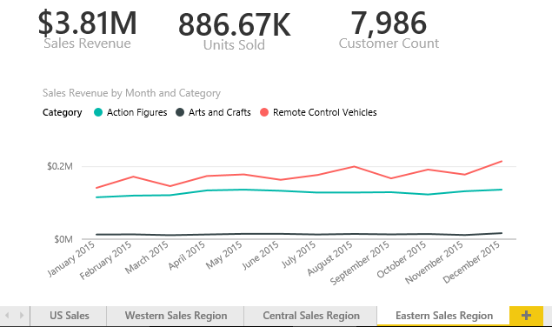
Reports and Pages
Reports contain one or more pages
A report can be designed with a single page
A report can be designed with many pages
Tabbed navigation located at bottom of report view
Each report is associated with exactly one dataset
Notes:
A report contains a collection of one or more pages. Simple report might contain just a single page while a more complicated report can contain 10 pages or more. It’s up to you to decide how many pages you want to add to each report you create.
Each report displays a tabbed navigation menu at the bottom. This provides the means to navigate between pages in a multipage page report. This menu also supplies a button with a plus (+) sign on the right which makes it possible to add new pages when a report is in design view. You can also right-click on a page in the tabbed navigation menu to rename a page or to duplicate it to clone a copy.
Keep in mind that each report is associated with exactly one underlying dataset. A report cannot see or display data from any other dataset. You should also understand that deleting a dataset will also delete any report that is based on that dataset.

Slide 4

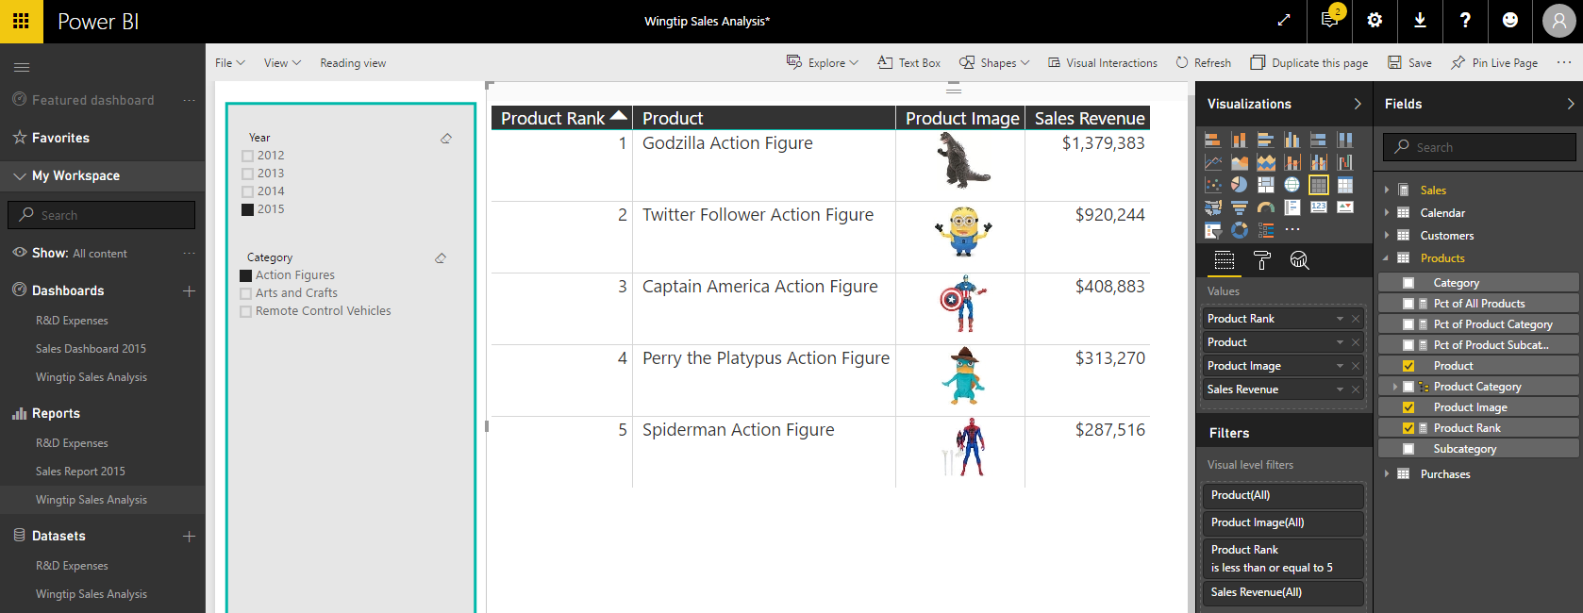
Report Authoring
Report initially opens in reading view
Click Edit report to switch to edit mode
Report design tools appear on right side of page
Notes:
Reports can be viewed in Reading view or in Edit view. When you first navigate to a report, it is initially displayed in reading view which means you cannot edit the report. However, you can click the Edit report button in the toolbar to move over into edit view whenever you need to edit a report.
When you switch a report from reading view to edit view, a set of report editing tools appear on the right side of the page. These tools such as the Visualizations pane and the Fields list make it possible to design reports by adding new visuals and configuring their properties.

Slide 5
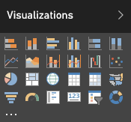
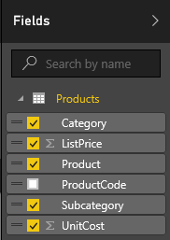
Visuals (aka Visualizations)
Reports are designed using visual (aka visualizations)
Each visuals is based on an underlying visualization type
Visualization type can be changed using Visualizations pane
Visuals creating by using fields from tables inside Fields list
Notes:
Pages within a report are designed by adding elements known as visuals. Note that Microsoft documentation uses the term “visual” and the term “visualization” interchangeably. In other words, there is no difference between a visual and a visualization. You sound a bit smarter when you use the term “visualization”, but it’s faster to say “visual” because the word only contain three syllables instead of six.
Each visual is based on an underlying visualization type. The set of visualization types available to you when designing a report are displayed in the Visualizations pane. Power BI defines a set of built-in visualization types which always appear in the Visualizations pane. One especially appealing aspect of the Power BI platform is that the set of available visualization types is extensible by adding custom visuals which you will learn about in module 6 of this training course.
When working with visuals while designing a report, you will often interact with the Fields list on the right side of the Power BI service application window. The Fields list displays all the tables and fields from the dataset associated with the current report. The Fields list is what makes it possible to associated one or more fields with a visual to populate it with data.

Slide 6
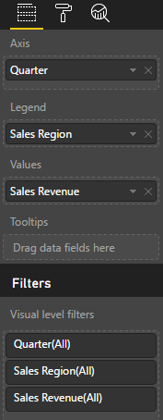
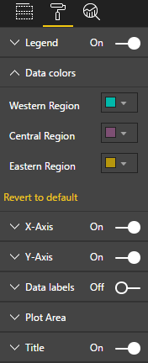
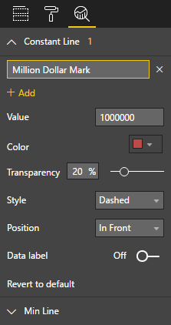
Editing Visual Properties
Visual properties modified using three property panes
Visual properties vary greatly depending on type of visualization
Fields Pane
Format Pane
Analytics Pane
Notes:
When you are working with the Power BI report editor in the browser, the properties of a visual can be modified using three different property panes on the right side of the Power BI service application windows. These three panes include the Fields pane, the Format pane and the Analytics pane. The screenshot in the slide above show where to click to activate each of these panes.
The Fields pane contains wells where you add fields from the tables of the dataset associated with the current report. The types of wells will vary greatly between different types of visualizations. For example, a line chart visual will contain wells such as Axis, Legend and Values. A map visual will contain wells such as Location, Legend and Size. A table visual only contains a single well for fields named Values.
The Format pane contains properties which affect the visual’s display characteristics such as color, font size and whether the visual will have a border.
The Analytics pane is a new comer as it was just added to the Power BI platform with the August 2016 updates. Currently, only a handful of visuals contain properties which is displayed in the Analytics pane. The purpose of the Analytics pane is to enhance a visual with analytical elements such as trend lines and constant lines.

Slide 7
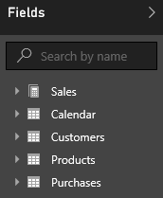
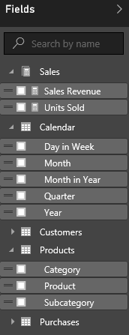
Report and Datasets
Each report is based on an underlying dataset
Fields list in report designer shows tables and fields
Report author sees tables & fields as dataset consumer
Notes:
As you know, each report is based on an underlying dataset. The Fields list displays the tables and fields from the dataset that is associated with the current report. When you begin to design report, the Fields list makes it possible to add fields into the wells inside the Fields pane for specific visuals so they can be populated with data.
When you are using the browser to edit a report, it is important to understand that you are only a dataset consumer. You have no ability to actually edit the underlying dataset. The next lecture of this training course will introduce you to a essential tool named Power BI Desktop. When you begin using Power BI Desktop, you will be able to begin editing and designing datasets with a powerful set of data modeling tools.

Slide 8
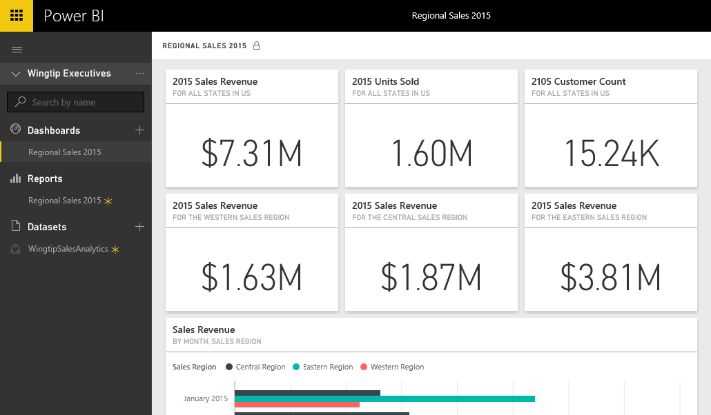
Dashboards and Tiles
Dashboard is a collection of tiles
Tile can be created by pinning visual from a report
Tile can be created by pinning Q&A result from dataset
Notes:
A dashboard in Power BI is displayed as a collection of dashboard tiles. There are two primary ways to create tiles when designing a dashboard. The most common way to create a tile in a dashboard is to pin a visual from a report. However, a tile can also be added to a dashboard in Power BI by executing the natural language Q&A query and then pinning the query results to create a new tile.

Slide 9
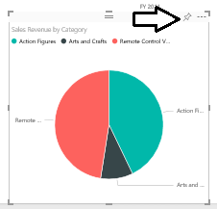
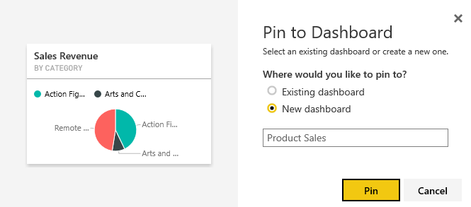
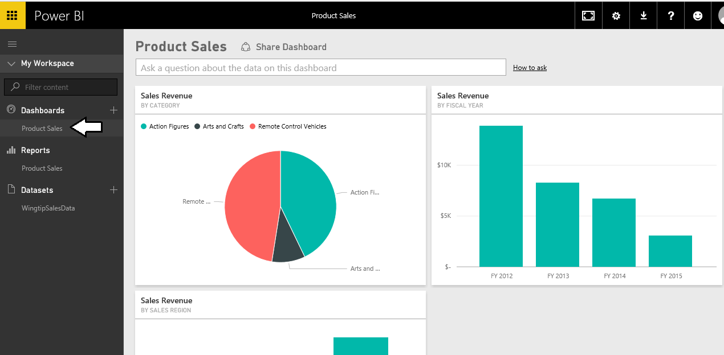
Creating Dashboards
Dashboards contain tiles
Tiles created from visuals on report pages
1
2
3
Notes:
Once you have created a report in your personal workspace, it’s pretty easy to take the next step and created a dashboard by following these steps.
Navigate to a report, hover the mouse over a visual and then click on the thumbtack button to pin it to a dashboard.
When the Pin to Dashboard dialog appears, you can elect to pin the visual to a new dashboard or to an existing dashboard.
Once you have pinned the visual, you can navigate to the dashboard and see the tile that has been created.

Slide 10
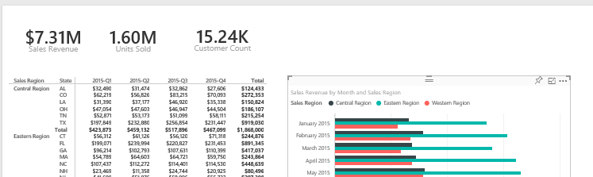
Dashboards and Reports
Dashboards link users to reports
Dashboard tiles designed to provide high-level view
Clicking tiles drills down into report to see more detail
Notes:
When you create a dashboard tile by pinning a visual from a report, you create a navigation path. When a user examines the dashboard and clicks on that tile, the user will be redirected to the underlying report.
This navigation path created by a dashboard tile emphasizes the key relationship between a dashboard and a report. The dashboard should be designed to convey a high-level overview of the data being analyzed. When a users sees something in a dashboard that needs further inspection, they can click on a tile to navigate to a report where they can dive down into greater levels of detail.

Slide 11
Project Lifecycle for a Custom BI Solution
Lifecycle of a typical BI project includes...
Discover where the data lives
Extract, transform and load (ETL) data
Model data to create dataset for analytics and reporting
Design and implement reports on top of dataset
Consolidate reports into one or more dashboards
Package custom solution artifacts for deployment
Deploy custom solution to production environment
Typical BI Project Lifecycle
Data Discovery
ETL
Data Modeling
Design Reports
Design Dashboards
Publish
Custom
Solutions
Notes:
For decades, people in the IT industry have been working on projects to support various forms of business intelligence. Regardless of the toolset being used, a project to create a custom BI solution typically follows a standard lifecycle moving from one phase to the next.
The first phase requires figuring out what you want to measure and then moving on to discover what data exists to support making these measurements. Next, you must work through the ETL phase where the data is extracted, transformed and loaded into some type of data model. In next phase, you engage in data modeling using something such as the multidimensional model or the tabular model to make the data better suited for data analysis and reporting.
Once you have designed a data model, the next step involves designing reports to display numeric figures and visual elements on the computer screen and/or the printed page. Depending on the tools you are using, reports might be complimented by the creation of dashboards or scorecards which are designed to provide a consolidated overview and key insights using visuals elements such as key performance indicators (KPIs).
The final step involves deploying all the work you have done into a production environment so that business users can begin using what you have built in the course of their daily work. This phase typically involves packaging reports and dashboards and using some type of distribution mechanism to make your custom solution available to the general user population.

Slide 12
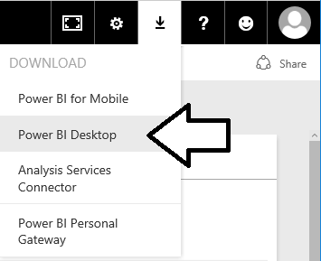
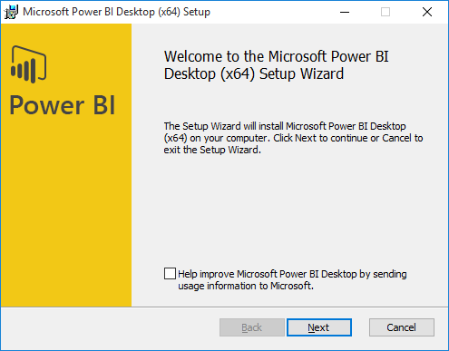
Installing Power BI Desktop
Power BI Desktop quick & easy to install over the Internet
Select Power BI Desktop option from Power BI Download menu
Power BI Desktop downloads & installs in less than a minute
Notes:
Of course, you can’t use Power BI Desktop until you installed it on a computer running Windows. Fortunately, it can be downloaded and installed in less than a minute using a standard Internet connection. Just log into the Power BI service and select the Power BI Desktop option from the Download menu to begin the download and installation process.
We recommend installing Power BI Desktop on a computer or a virtual machine running a 64-bit version of either Windows 10 or Windows Server 2016. However, it is possible to install Power BI Desktop on older 32-bit versions of Windows all the way back to Windows 7 and Windows Server 2008 R2. The main advantage of using a 64-bit version of Windows over a 32-bit version is that you can load much larger datasets into memory and you can install and test Power BI Gateways which do not support 32-bit operating systems.
Power BI Desktop is built on top of .NET Framework version 4.5 which is automatically installed with recent versions of Windows. However, older versions of Windows might require you to download and install .NET Framework version 4.5 before you will be able to install Power BI Desktop.

Slide 13
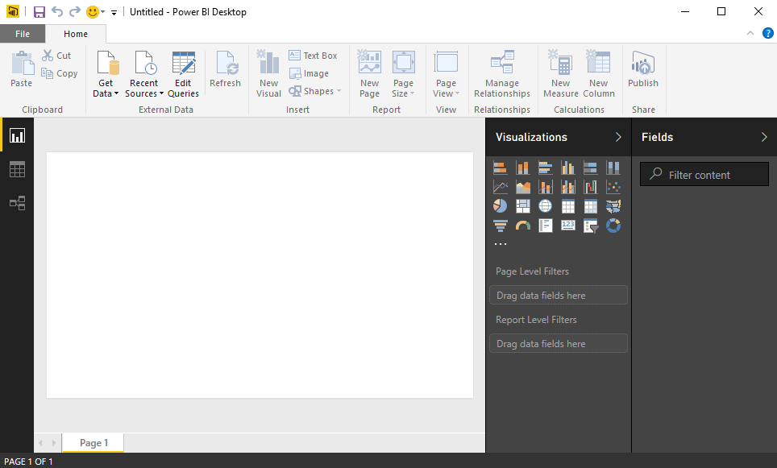
Working with Power BI Desktop
Power BI Desktop is a Windows application
Work is saved and published in terms of projects
You can work on multiple projects at once
Each project runs in its own Power BI Desktop instance
Power BI Desktop can freeze up or act buggy
Quit & restart Power BI Desktop if it acts strangely
Notes:
When you work with Power BI Desktop, all the work you do creating queries, modeling data and designing report is saved and published in terms of projects. For example, you might create one project for expense reporting and another project to create a mobile dashboard for sales analysis.
Power BI Desktop has commands to open projects and to create new project but it provides no command to close a project. For this reason, it’s easy to start up several instances of Power BI Desktop at once by mistake which can become confusing. When you are done working on a project, you should quit that instance of Power BI Desktop to keep the number of running instances of Power BI Desktop to a minimum.
Power BI Desktop is a cutting-edge Windows application. There are many parts of it that you will absolutely love. But you must keep in mind that Power BI Desktop is an application that has very short release cycles and constantly introduces new preview features. It’s not going to be as polished or as stable as some of your other favorite Windows applications.
There will likely be a time this week when you are cussing out Power BI Desktop because it’s frozen up on you after you’ve done a bunch of design work without saving your changes. Other times Power BI Desktop might prompt you with dialog boxes that don’t display correctly. If you think that Power BI Desktop is behaving strangely, save you work then shut it down and restart it. But don’t let this get you down. We would have never gotten to the moon if we were too afraid to take risks.

Slide 14

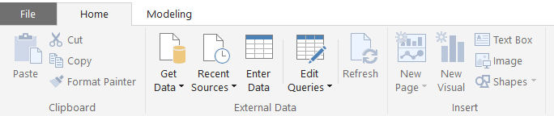
Getting Around in Power BI Desktop
What do you need to learn to use Power BI Desktop?
Query features for importing data
Design features for modeling data
Report designer for creating reports
Navigating between view modes
Report View
To access query features
Data View
Relationship View
Notes:
What do you need to learn to get up to speed on Power BI Desktop? There are three main areas to focus on at first which include creating queries, modeling data and designing reports. First, you must learn how to design queries which import data. The creation of queries is what allows you to create a base set of tables in the dataset for a Power BI Desktop project. Next, you must learn how to use the data modeling features so you can extend the project’s dataset to create a rich data model with things like calculated columns, measures and hierarchies. After that, you must learn how to use the report designer in Power BI Desktop to present the data analysis for your project using tables and visual images and to provide the user with interactive capabilities.
You will use Power BI Desktop’s main application window to model data and to design reports. The main application window provides a left navigation menu that allows you to switch back and forth between report view, data view and relationship view. When you need to create and design queries, you will do that in a separate Query Editor window which can be opened using one of the menu buttons in the ribbon of the main application window inside the External Data group on the Home tab.

Slide 15
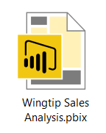
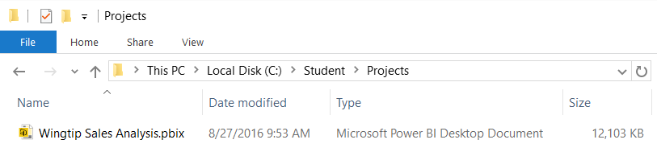
Projects and PBIX Files
Power BI Desktop projects saved using PBIX files
PBIX file contains data source definitions
PBIX file contains query definitions
PBIX file contains data imported from queries
PBIX file contains exactly one data model definition
PBIX file contains exactly one report
PBIX file never contains data source credentials
Notes:
Power BI Desktop projects are saved, loaded and published using PBIX files. A PBIX file is a ZIP archive created using the Open Packaging Convention format just like common Office documents such as DOCX files and XLSX files. The files for datasets that are stored inside and loaded from a PBIX file are managed internally by Power BI Desktop using Microsoft’s xVelocity Tabular database engine.
Each project created using Power BI Desktop is stored as a single PBIX file. Just about everything you create and configure when using Power BI Desktop is stored inside the PBIX file for one specific project. A PBIX file stores data source definitions and query definitions as well as tables of data which are populated and refreshed when queries are executed. A PBIX files also includes all the work you have done with data modeling and report design.
From a project management perspective, it’s important to understand that a PBIX file represents a single project which contains exactly one dataset and exactly one report. You cannot add a second report to a Power BI Desktop project. However, you can add as many pages as you would like to a project’s one and only report.
You should take note that Power BI Desktop will never store data source credentials in a PBIX file. For example, PBIX files never contain the user name and password required to access a secured resource such as a Online service or an on-premises SQL server database. Instead, Power BI Desktop provides the convenience of storing data source credentials in a local cache so you are not required to continually log into the same data source when working with Power BI Desktop. But these credentials are never published along with a PBIX file. After you publish a Power BI Desktop project by uploading its PBIX file, you will be required to configure data source credentials separately using the browser or by using some other automated technique.

Slide 16
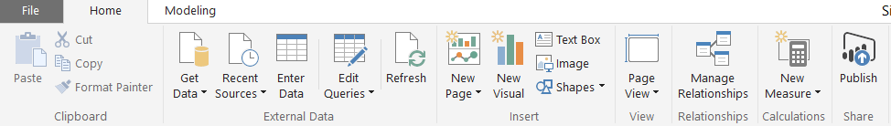
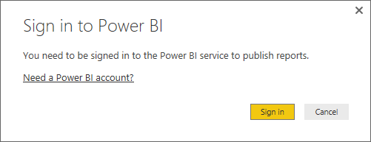
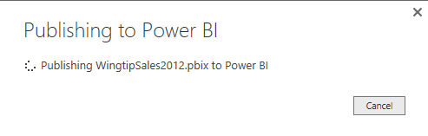
Publishing a Power BI Desktop Project
Power BI Desktop provides Publish command
Used to publish project to Power BI service
Requires logging into your Office 365 account
Published articles added to target workspace
Notes:
When you have completed designing the data model and report for a Power BI Desktop project, the next step is to publish it which effectively deploys your project to the Power BI service in the Microsoft cloud. You can execute the Publish command using the Publish command button in the ribbon or the Publish menu command in the File menu.
In order to publish a Power BI Desktop project, you must establish a login session from Power BI Desktop to the Power BI service. Once you have logged into the Power BI service using an Office 365 account with a Power BI license, you can then publish the project to your personal workspace or any group workspace in which you have editing permissions.

Slide 17
Working with DAX
DAX is the language used to create data models
DAX stands for "Data Analysis Expression Language"
DAX expressions are similar to Excel formulas
They always start with an equal sign (=)
DAX provides many built-in functions similar to Excel
DAX Expressions are unlike Excel formulas…
DAX expressions cannot reference cells (e.g. A1 or C4)
Instead DAX expressions reference columns and tables
=SUM('Sales'[SalesAmount])

Slide 18
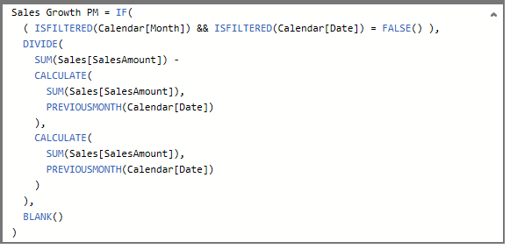
Writing DAX Expressions
Some DAX expressions are simple
Some DAX expressions are far more complex

Slide 19
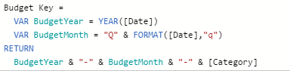
Creating Variables in DAX Expressions
Variables can be added at start of expression
Use VAR keyword once for each variable
Use RETURN keyword to return expression value

Slide 20
Calculated Columns vs Measures
Calculated Columns (aka Columns)
Evaluated based on context of a single row
Evaluated when data is loaded into memory
Measures
Evaluated at query time based on current filter context
Commonly used for aggregations (e.g. SUM, AVG, etc.)
Used more frequently than calculated columns
Column1 = <DAX expression>
Measure1 = <DAX expression>

Slide 21
When to Create Calculated Columns
Measures often better choice than calculate columns
Don't create calculated column when you need a measure
Prefer to create calculated columns only in specific scenarios
When should you create calculated columns?
To create headers for row labels or column labels
To place calculated results in a slicer for filtering
Define an expression strictly bound to current row
Categories text or numbers (e.g. customer age groups)

Slide 22
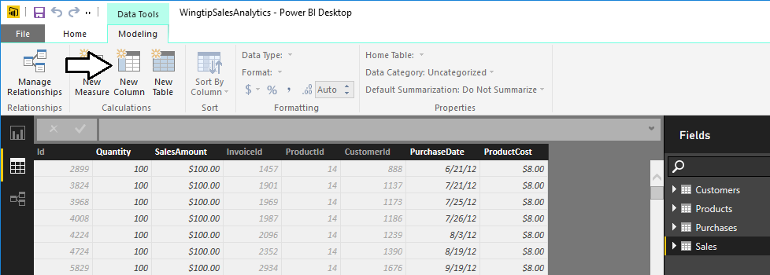
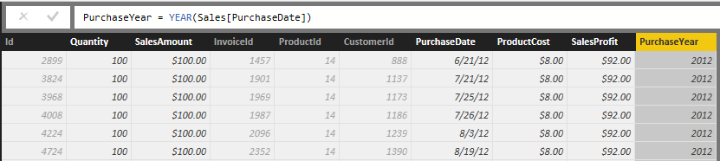
Creating Calculated Columns
Edited in formula bar of Power Pivot data view
Start with name and then equals (=) sign
Enter a valid DAX expression
Clicking on column adds it into expression

Slide 23
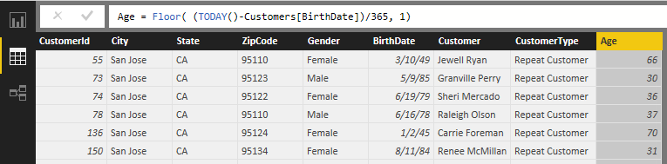
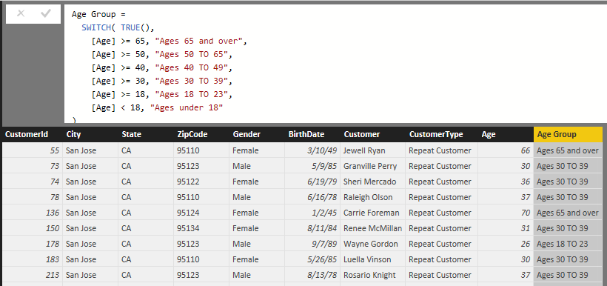
Calculated Column for Customer Age Group
Calculate customer age from birthdate
Calculate age groups using calculated column

Slide 24
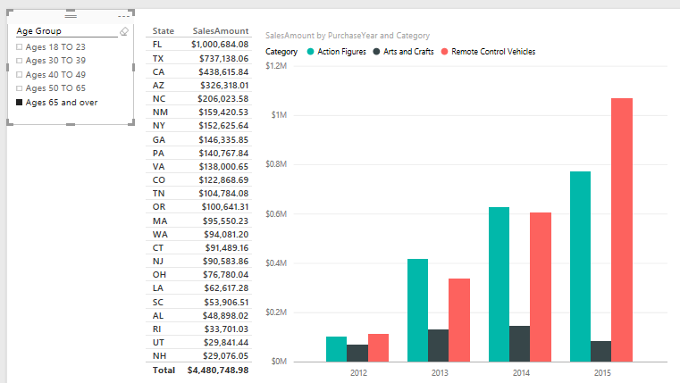
Calculated Column used in a Slicer
Calculated column can populate slicer values

Slide 25
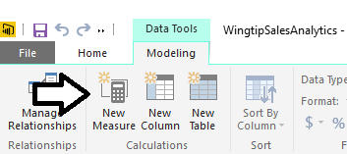
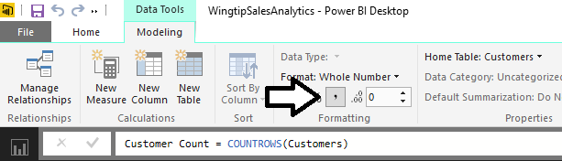
Creating Measures
Measures have advantage over calculated columns
They are evaluated based on the current evaluation context
Creating a measure with Power BI Desktop
Click New Measure button
Give measure a name and write DAX expressions
Configure formatting
1
3
2

Slide 26
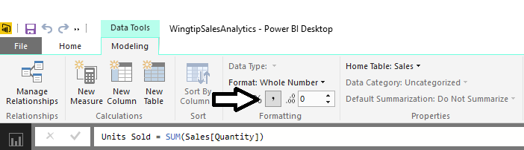
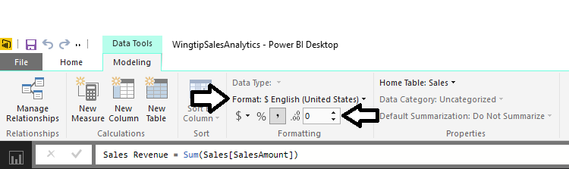
Formatting Measures
Format as whole number
Format as currency

Slide 27
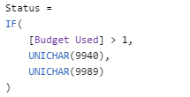
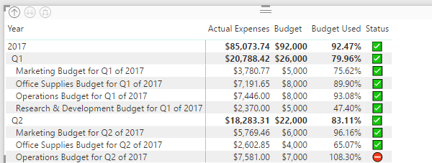
Working with UNICHAR Characters
Create a measure to return a single UNICHAR character
There are many different UNICHAR characters with symbols
UNICHAR character symbols can be displayed in table or matrix

Slide 28
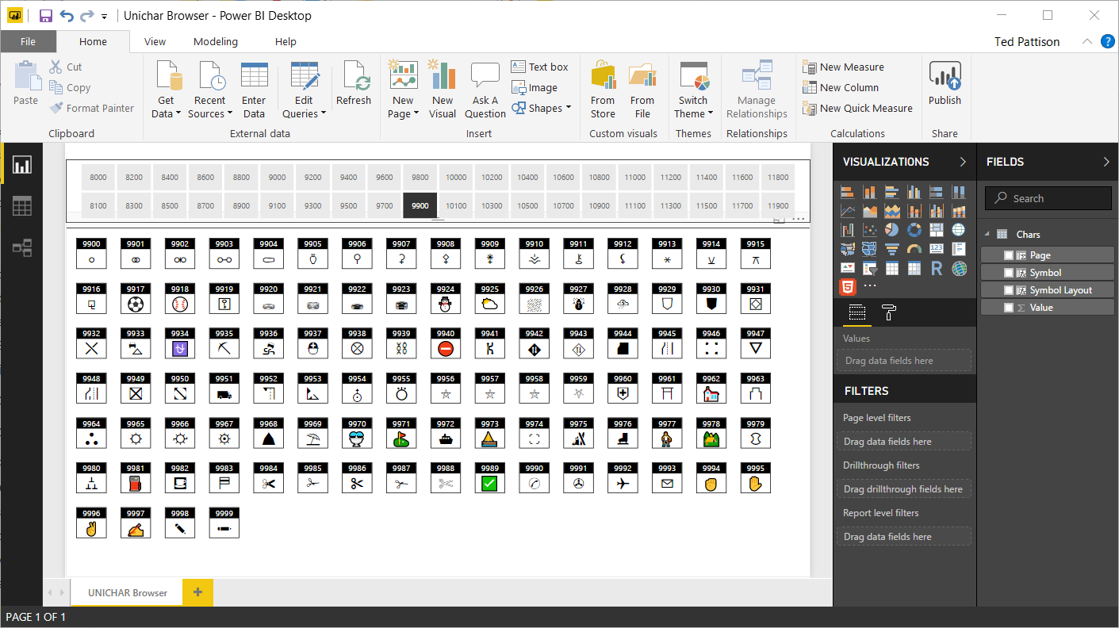
The UNICHAR Browser Demo

Slide 29
Agenda
Creating Table Relationships
Creating Calculated Columns and Measure
Creating Tables using DAX Expressions
Configuring Fields for Geographic Mapping
Creating Dimensional Hierarchies
Using the DAX Calculate Function
Calendar Tables and Time Intelligence

Slide 30
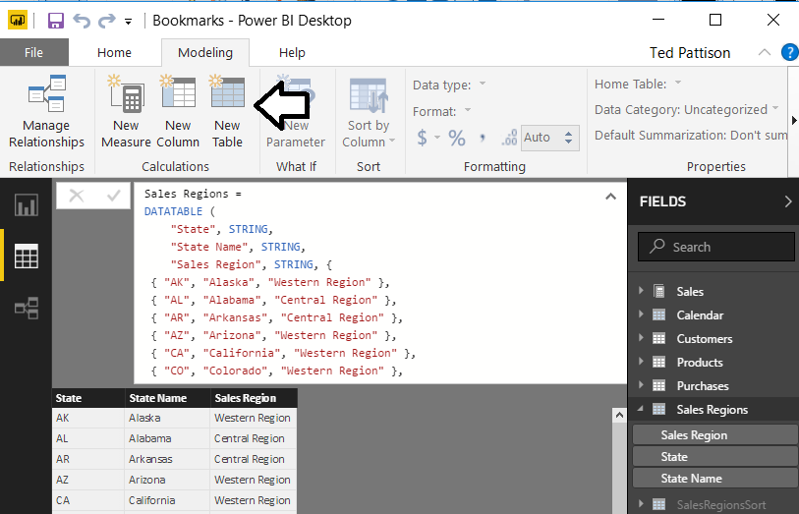
Creating Tables Dynamically using DAX

Slide 31
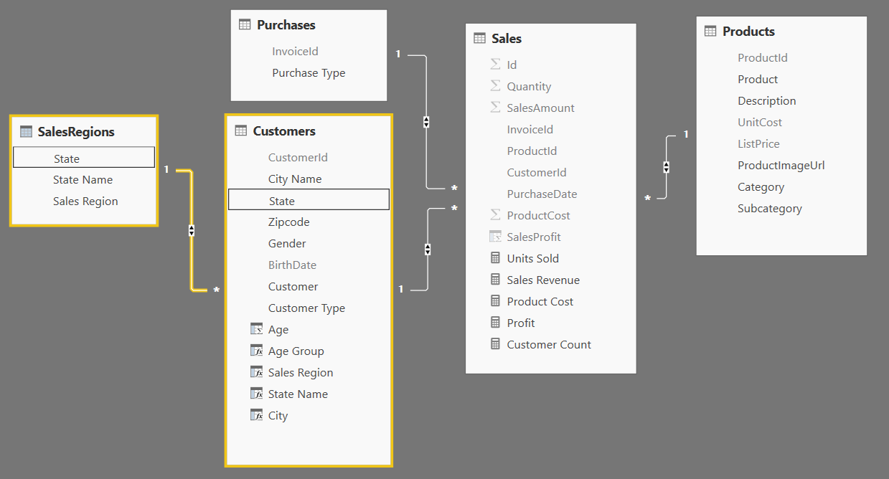
Integrating the Lookup Table into the Data Model
Lookup table must be integrated into data model
Accomplished by creating relationship to one or more tables

Slide 32
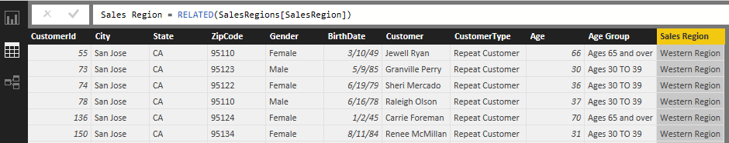
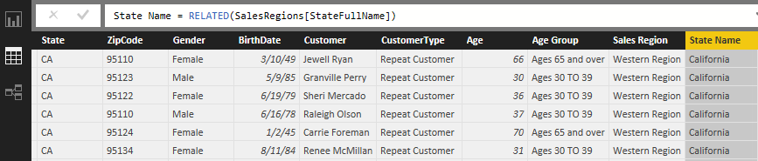
The RELATED Function
RELATED function performs cross-table lookup
Effectively replaces older VLOOKUP function
Used in many-side table to look up value from one-side
Used to pull data from lookup table into primary table

Slide 33
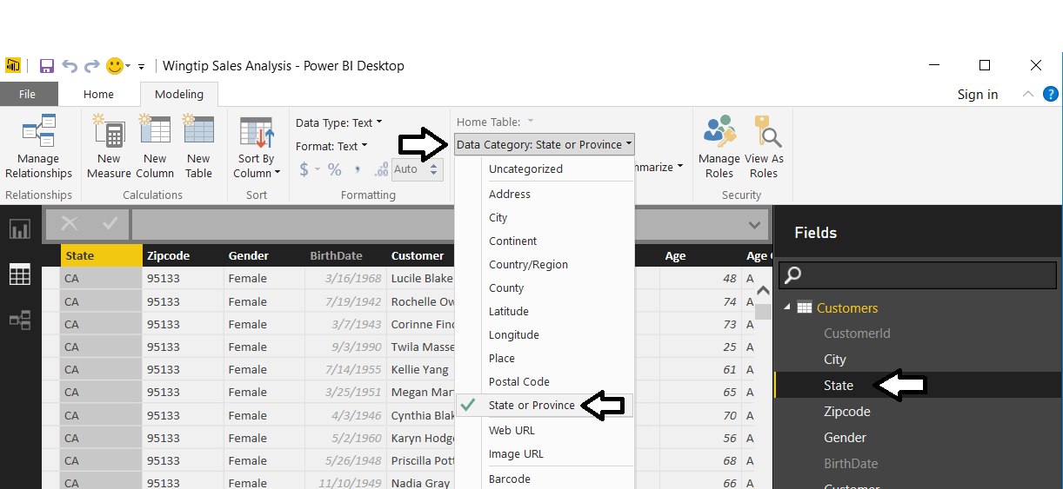
Geographic Field Metadata
Fields in data model have metadata properties
Metadata used by visuals and reporting tools
Used as hints to Bing Mapping service

Slide 34
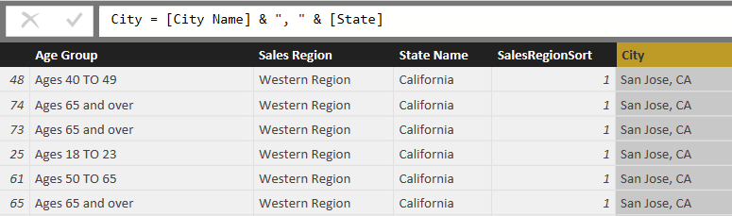
Eliminate Geographic Ambiguity
City name alone is ambiguous
"Athens" defaults to Greece not Georgia
Concatenate city name with state to disambiguate

Slide 35
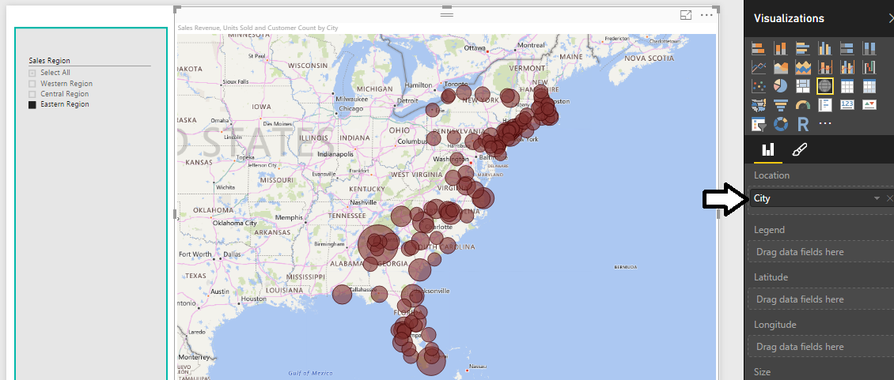
Using Map Visual with a Geographic Field
Map Visual shows distribution over geographic area
Visual automatically updates when filtered

Slide 36
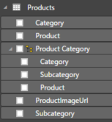
Dimensional Hierarchies
Hierarchy created from two or more columns
All columns in hierarchy must be from the same table
Defines parent-child relationship between columns
Provides path to navigate through data
Provides path to drill down into greater level of detail

Slide 37
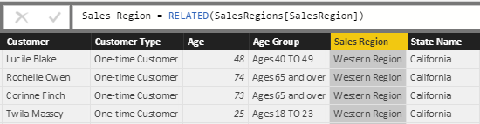
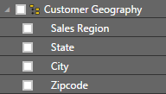
Pulling Columns for Hierarchy into Single Table
Sometimes hierarchy columns are spread across tables
Use RELATED function from DAX to pull columns into single table
Then create hierarchy in the table with all the columns

Slide 38
A Tale of Two Evaluation Contexts
Row Context
Context includes all columns in iteration of current row
Used to evaluate DAX expression in calculated column
Only available in measures with iterator function (e.g. SUMX)
Filter Context
Context includes filter(s) defining current set of rows
Used by default to evaluate DAX expressions in measures
Can be fully ignored or partially ignored using DAX code
Not used to evaluate DAX in calculated columns

Slide 39
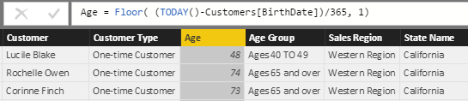
Understanding Row Context
Row context used to evaluate calculated columns

Slide 40

Understanding Iterators Like SUMX
Standard aggregation functions (e.g. SUM) have no row context
You can use SUM to sum values of a single column
You cannot use SUM to sum results of an expressions
Iterator functions (e.g. SUMX) iterate through rows in target table
First argument accepts expressions that evaluates to table of rows
Second argument accepts expression that is evaluated for each row

Slide 41
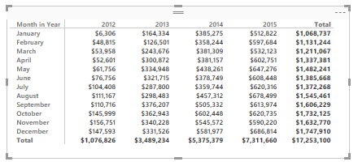

Understanding Filter Context
Visuals apply various filters in different evaluation contexts
Filter context also affected by slicers and other filters
Filters on this evaluation
[Year] = 2015
[Month in Year] = "October"
Filters on this evaluation
[Year] = 2015
[Month in Year] = "October"
[Sales Region] = "Western Region"
[Customer Type] = "Repeat Customer"

Slide 42


Using the CALCULATE Function
CALCULATE function provides greatest amount of control
First argument defines expression to evaluate
Second argument defines table on which to evaluate expression
You can evaluate expressions with or without current filter context

Slide 43


Creating Calendar Table as Calculated Table
Use New Table command in ribbon
Create calendar table using DAX CALENDAR function

Slide 44



Adding Columns to Calendar Table
Creating the Year column
Creating the Quarter column
Creating the Month column

Slide 45


Configuring Sort Columns
Month column will not sort in desired fashion by default
For example, April will sort before January, February and March
Creating a sort column for the Month column
MonthSort sorts alphabetically & chronologically at same time
Configure Month column with MonthSort as sort column

Slide 46




Columns for Month in Year and Day in week
Creating the Month in Year column
Creating the MonthInYearSort column
Creating the Day of Week column
Creating the DayOfWeekSort column

Slide 47

Integrating Calendar Table into Data Model
Calendar table needs relationship to one or more tables

Slide 48


Calculated Fields for QTD and YTD Sales
TOTALQTD function calculates quarter-to-date totals
TOTALYTD function calculates year-to-date totals

Slide 49

Creating Running Total using CALCULATE
Calculate a running total of sales revenue across years
This must be done using CALCULATE function

Slide 50


Sales Growth PM Measure - First Attempt
Create a measure named Sales Growth PM
Use measure in matrix evaluating month and quarter
Measure returns correct value when filtered by Month
Measure returns large, erroneous value when filtered by Quarter

Slide 51


Using the ISFILTERED Function
ISFILTERED function used to determine when perform evaluation
Expression returns Blank value when evaluation context is invalid

